Slide 1
OT-ST-WS-08 | Data preparation
2. Climate model data (Nikolay Koldunov)

Slide 2
Where to find material
Code and presentations are located: https://github.com/koldunovn/DT_model_data
Nikolay Koldunov
Scientist at Alfred Wegener Institute for Polar and Marine Research (awi.de)
Work with ocean and climate models, specialise on very high resolution modelling, Arctic Ocean and sea ice.
More than 15 years of experience working with climate model data, more than 13 years I am doing it with python.
Website: http://nikolay.koldunov.net/
Tweeter: @oceanographer

Slide 3
What this course is about?
We are going to look at data produced by Earth System Models (and a bit from observations).
Mostly this will be models of Atmosphere and Ocean.
If it's not your main field of research, the data from those models can still be useful for you as a boundary conditions/information about the environment.

Slide 4
Types of data we going to work with
- Observational data (that gows in Numerical weather prediction models)
- Reanalysis
- Climate simulations

Slide 5
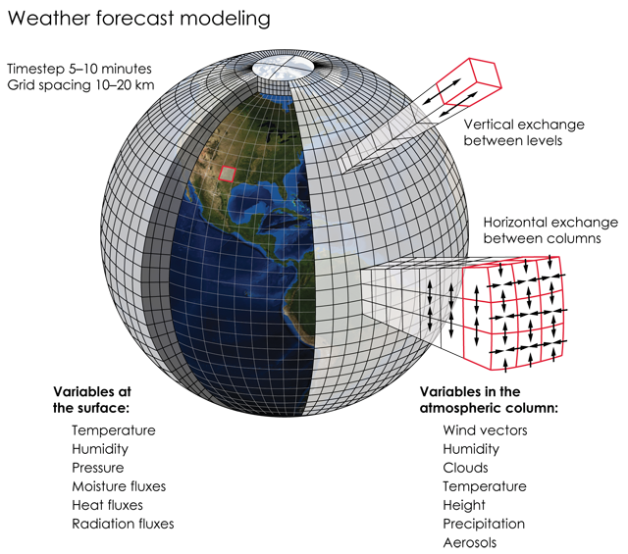
Numerical weather prediction models
Models that predict the weather.
Credits: K. Cantner, AGI.
Notes:
About 130 TB/day written (source https://www.ecmwf.int/sites/default/files/medialibrary/2019-01/02_DELLACQUA_INDUSTRYDAY_20190116.f.pdf)

Slide 6
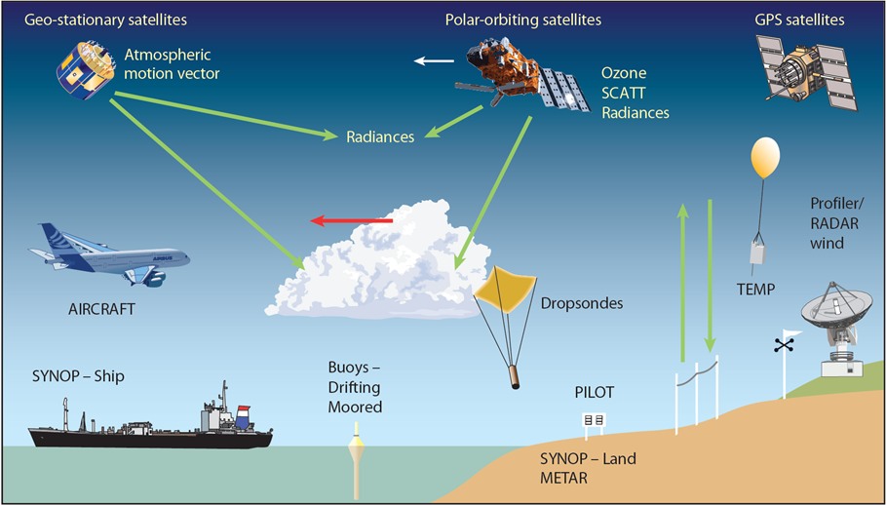
Data assimilation
Source: https://www.ecmwf.int/en/research/data-assimilation/observations
Notes:
ECMWF routinely processes data from around 90 satellite instruments as part of its operational daily data assimilation and monitoring activities. We receive 800 million observations daily, and 60 million quality-controlled observations are available daily for use in the Integrated Forecasting System (IFS); the vast majority of these are satellite measurements, but ECMWF also benefits from all available observations from non-satellite sources, including surface-based and aircraft reports.

Slide 7
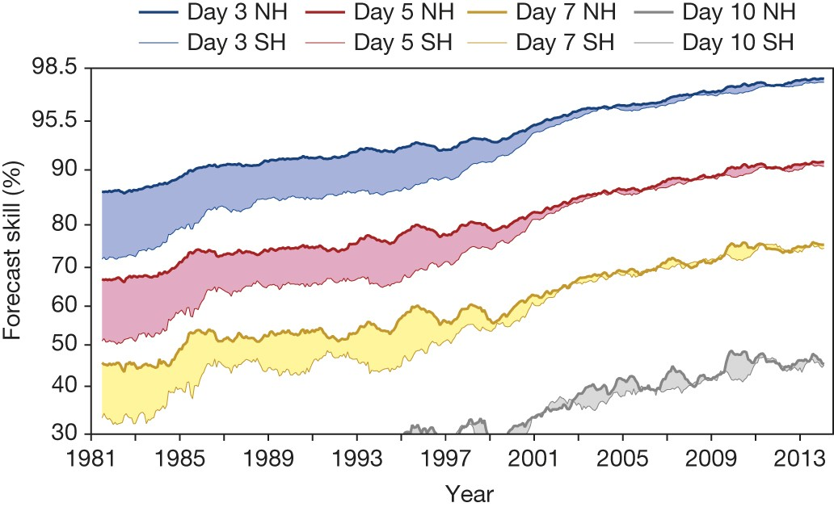
Improvements in NWP
Brauer et al., 2015 (The quiet revolution of numerical weather prediction)

Slide 8
Where to find data
Open plots from ECMWF
https://apps.ecmwf.int/webapps/opencharts
DWD open data server
https://www.dwd.de/EN/ourservices/opendata/opendata.html

Slide 9
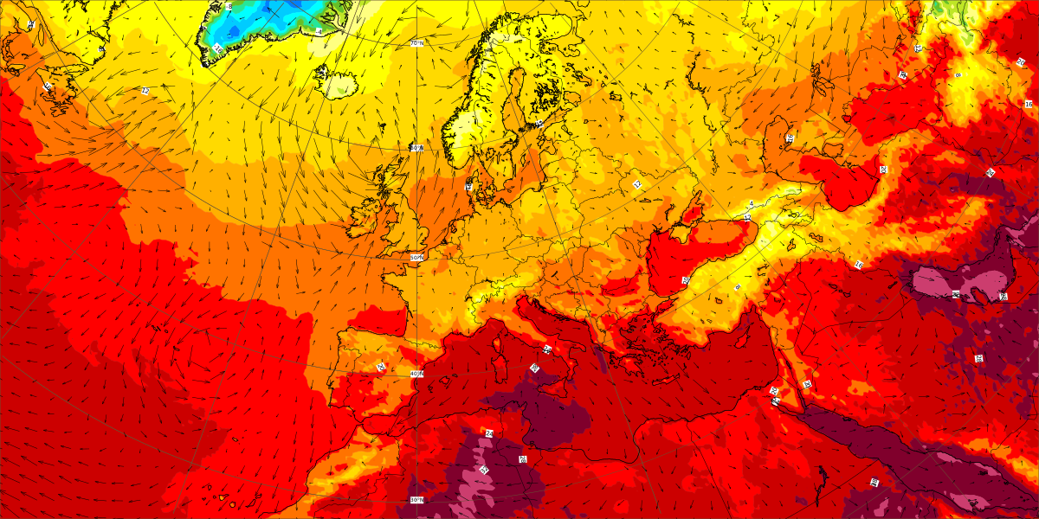
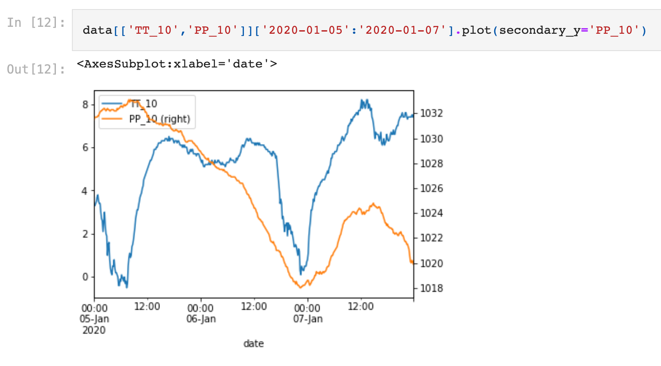
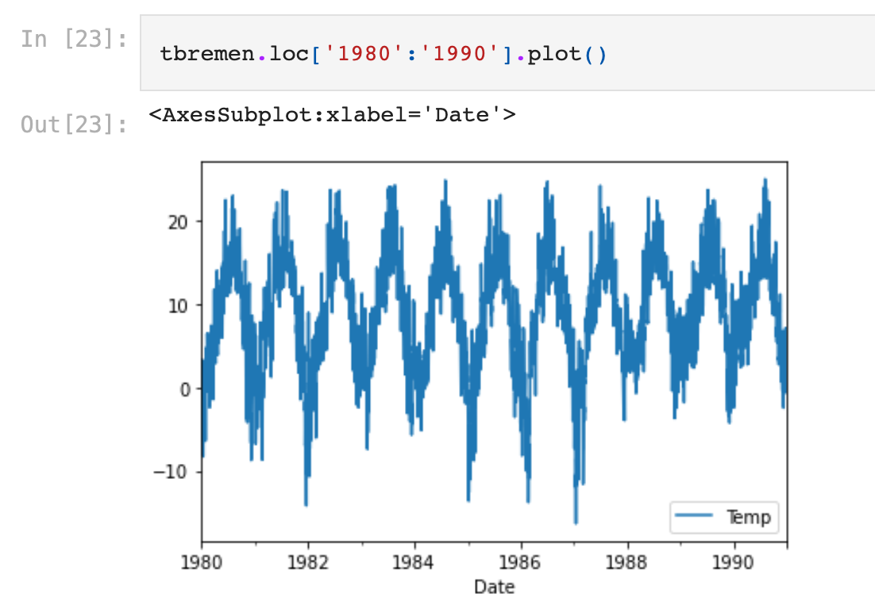
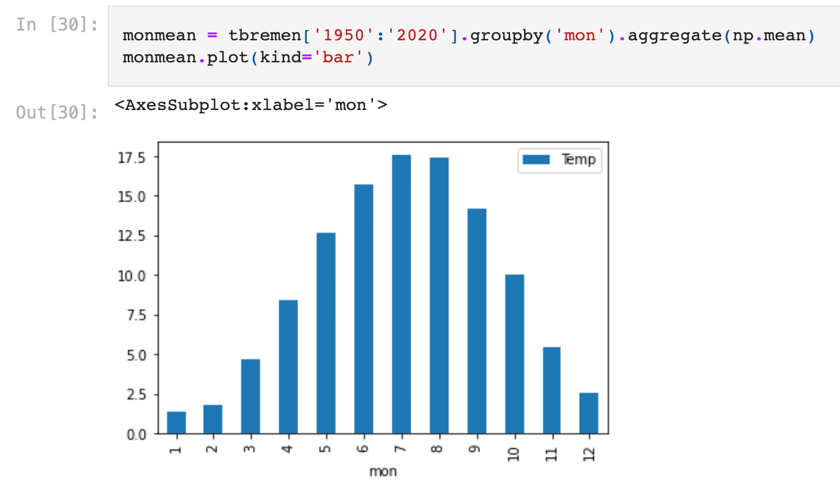
Working with meteorological records/timeseries
Where we can get weather data?
How to get basic point meteorological parameters in Germany with 10 minute intervals.
Working with daily world-wide data

Slide 10
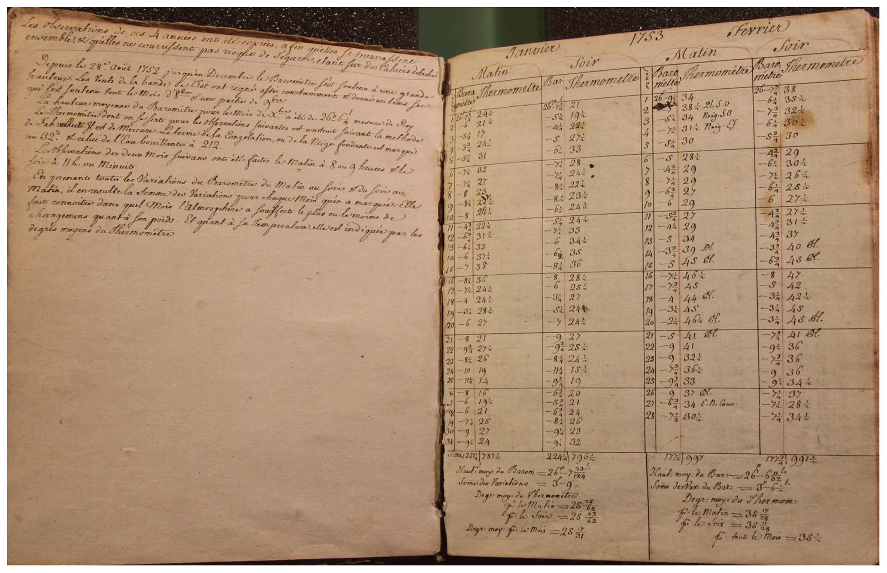
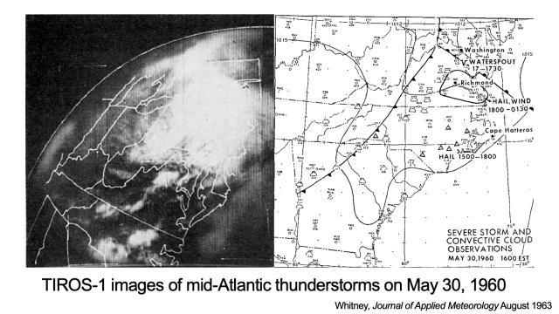
Reanalysis
Climate reanalyses combine past observations with models to generate consistent time series of multiple climate variables.
Sources: https://essd.copernicus.org/articles/12/1179/2020/ https://www.wral.com/first-weather-satellite-launched-this-day-in-1960/18297849/

Slide 11
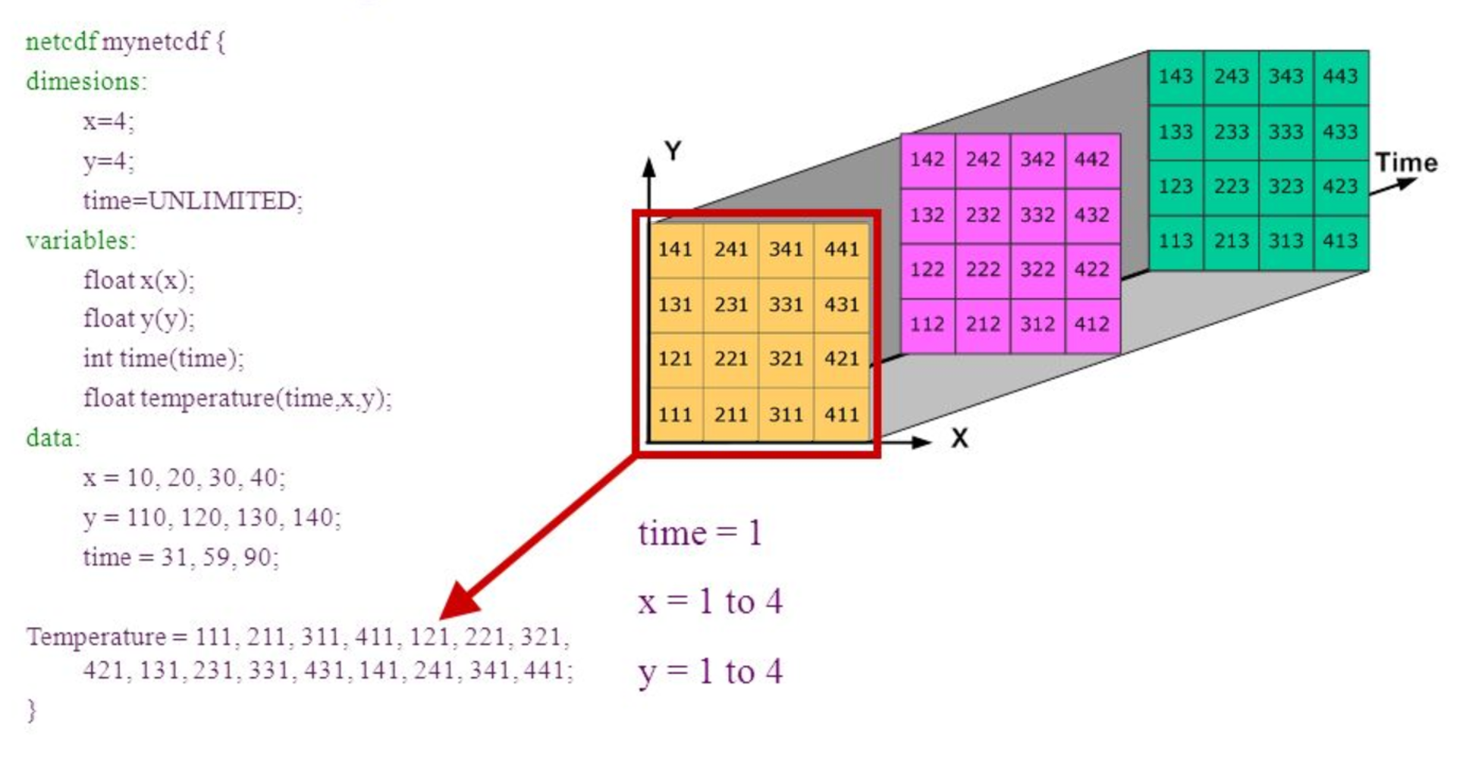
NetCDF files
De-facto standard for storing climate model data and many other geophysical fields.
Source: https://adyork.github.io/python-oceanography-lesson/17-Intro-NetCDF/index.html

Slide 12
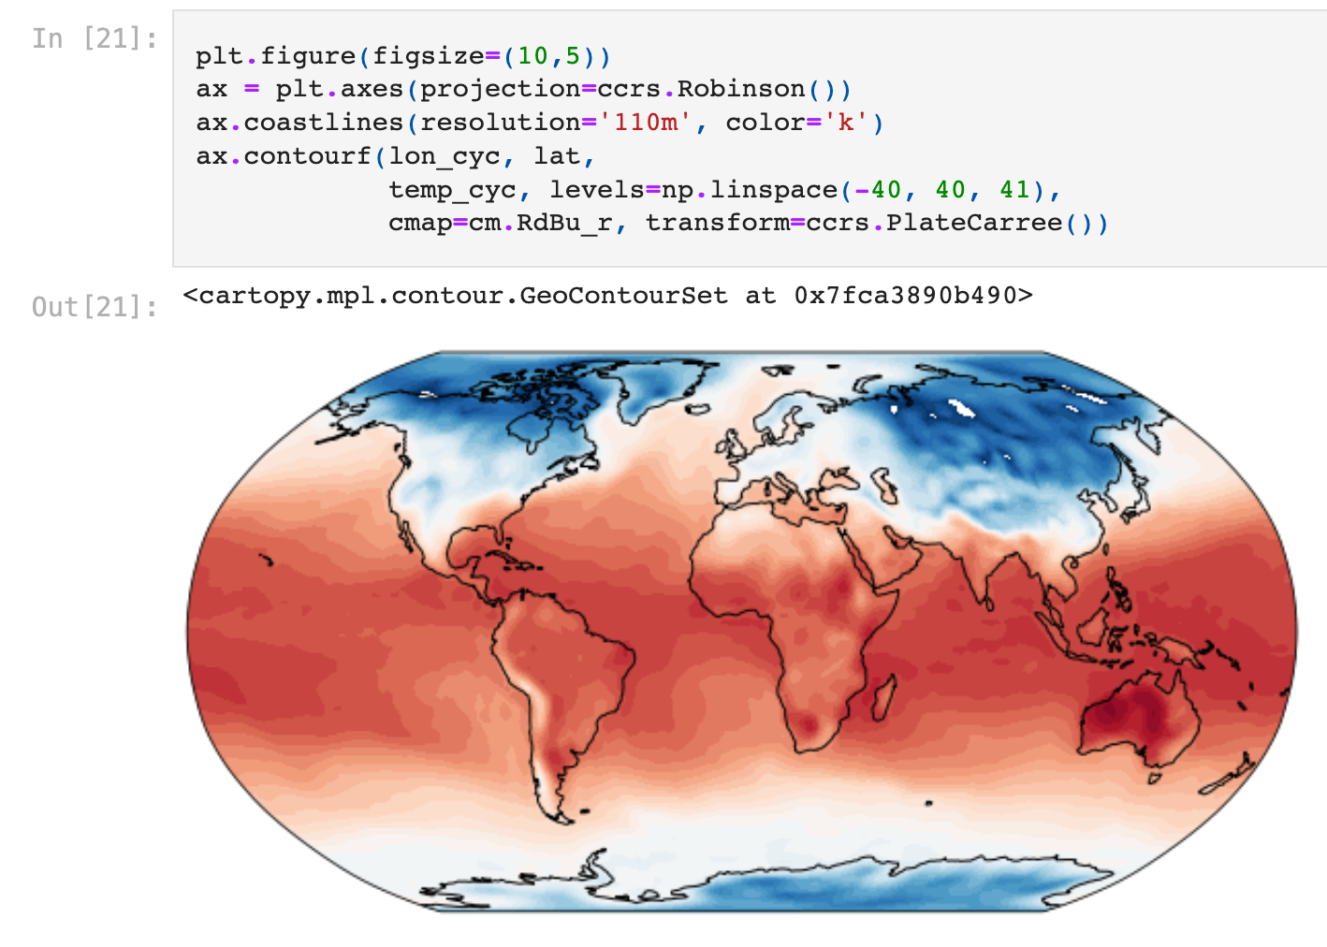
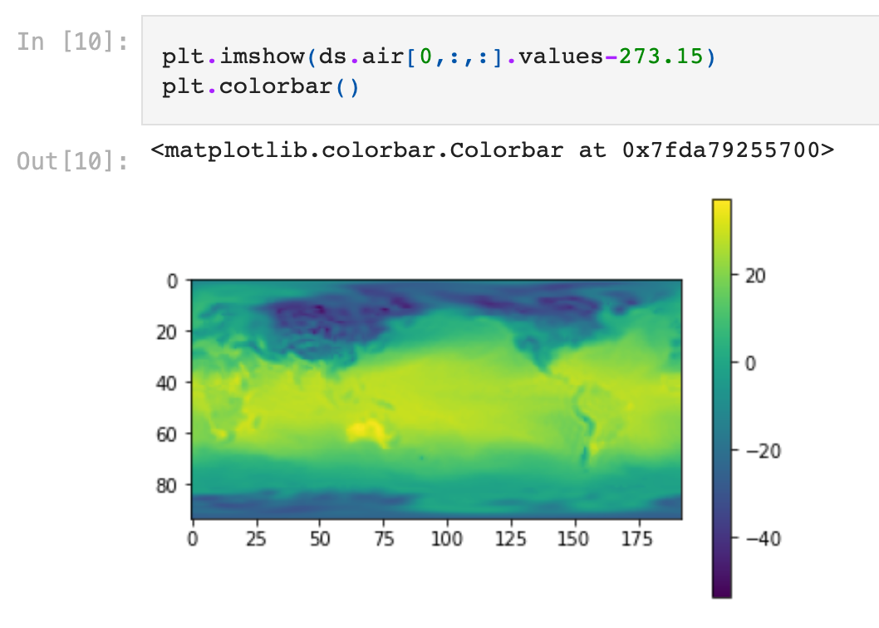
Reanalysis/Climate data in netCDF
What is netCDF, how to open it and make a simple plot:
Plotting data on the map

Slide 13
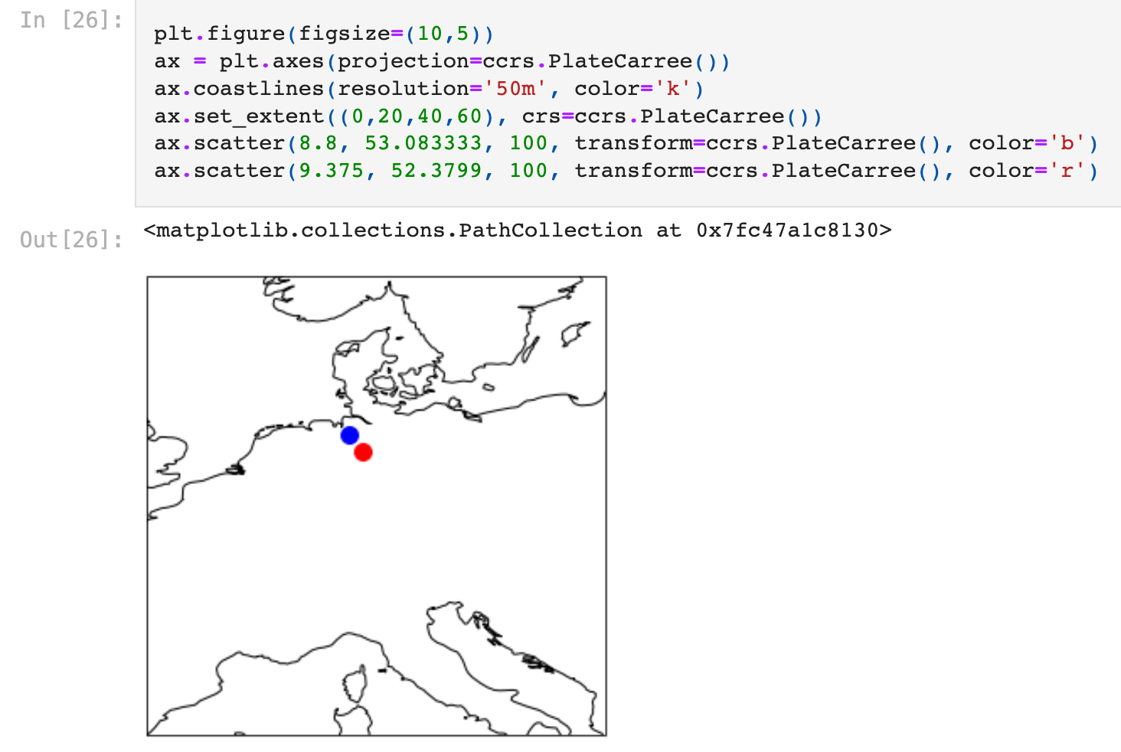
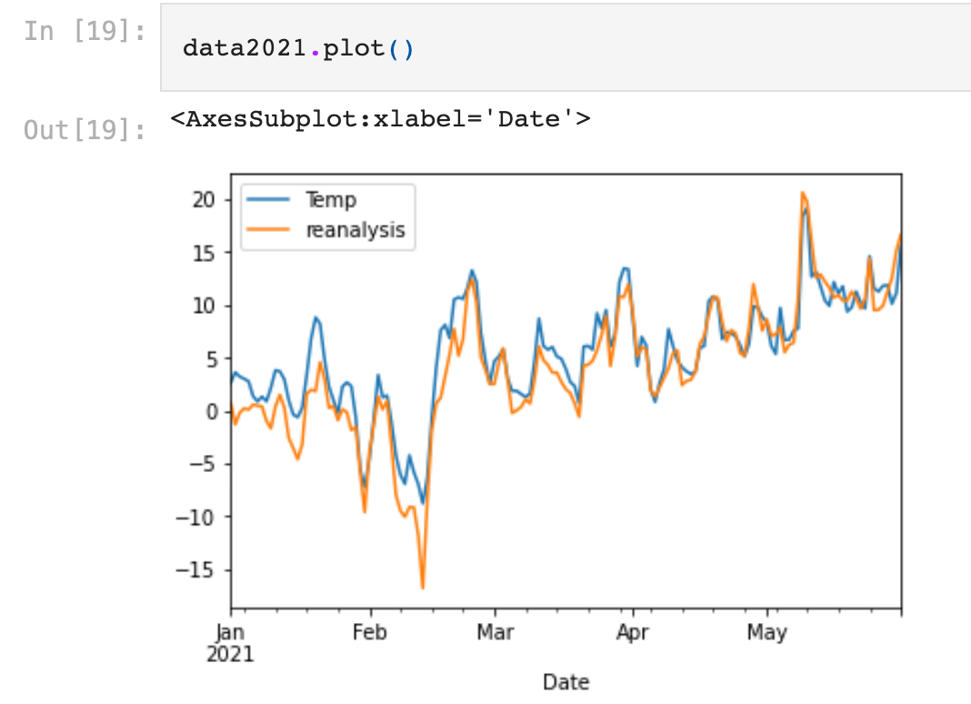
Reanalysis/Climate data in netCDF
Combine observational and reanalysis data

Slide 14
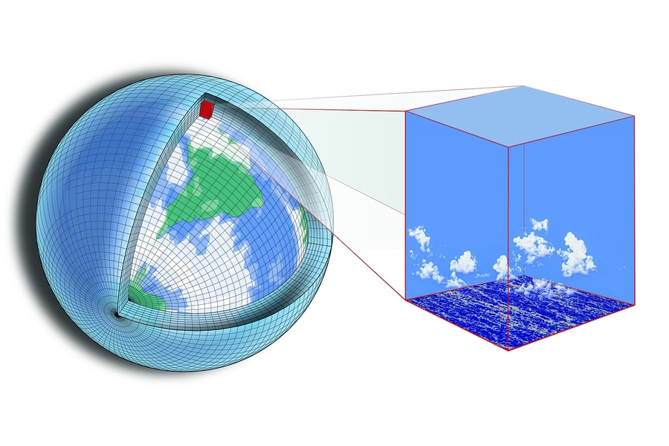
Climate simulations
Done with climate models, which can be different to NWP models.
They do not have data assimilation, use only limited forcing like GHC concentrations or solar irradiance.
Can be computed for past conditions (paleo simulations) or future (scenario simulations).
Source: https://news.mit.edu/2018/new-climate-modeling-alliance-clima-1212
Main components of climate modesl are Ocean, Atmosphere and Sea ice. The ESM models can include more componentd of the climate system, like vegitation, ice sheets, biogeochemistry and so on.

Slide 15
CMIP for IPCC
The most famous project of model intercomparison is CMIP (climate model intercomparison project) https://www.wcrp-climate.org/wgcm-cmip
Many modelling centres perform model simulations with their models according to the same protocol and made results available. The main source of CMIP data is ESGF: https://esgf-data.dkrz.de/projects/esgf-dkrz/
Results of the simulations provide input for IPCC reports and huge amount of scientific publications.

Slide 16
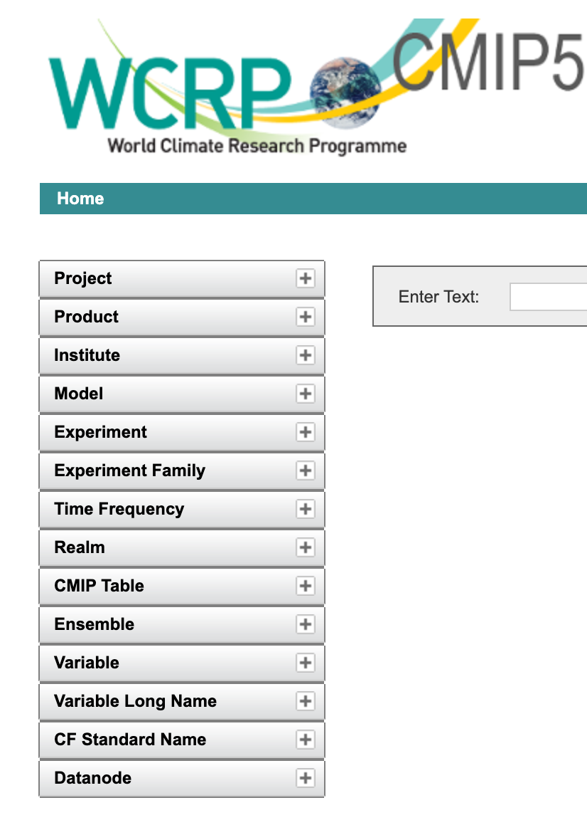
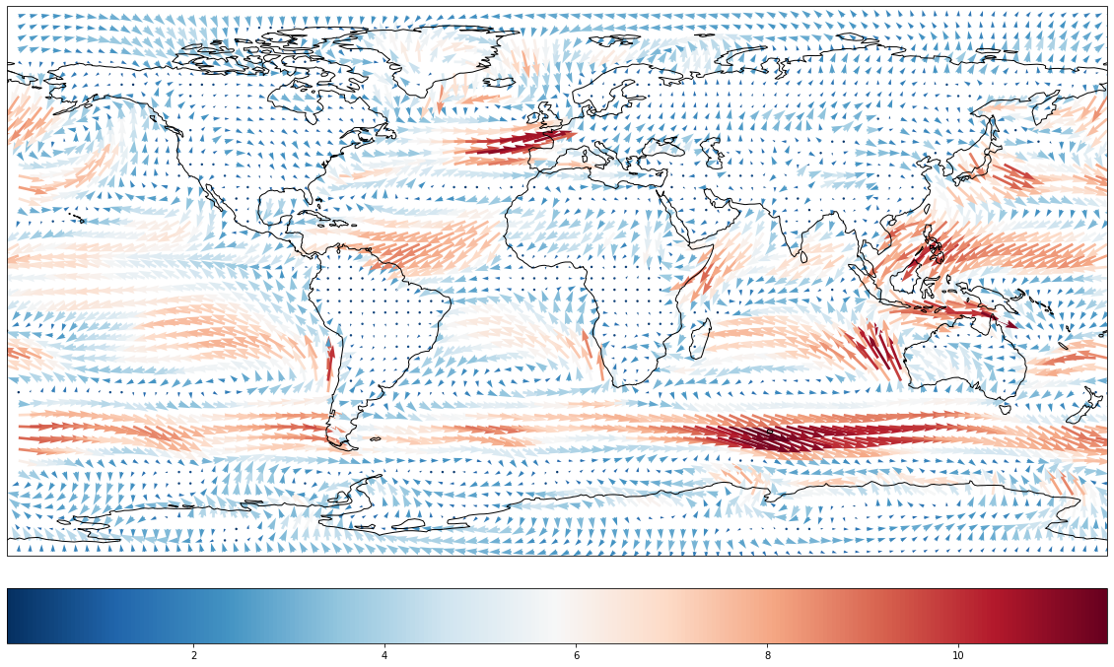
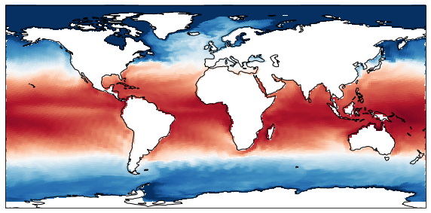
What we will learn?
Select model simulations from ESGF
Postprocess and plot the data

